Slide 1

Smart Inventory & Billing
Capstone Project by Marzooq C

Slide 2
Project Overview
Overview of the Capstone Project
Abstract Summary
This project addresses inefficiencies in inventory management and billing, showcasing a Python-based system that automates processes, enhances accuracy, and generates detailed reports for informed decision-making.

Slide 3
Problem Statement
Addressing inefficiencies in processes
Inventory Inefficiency
The current inventory management and billing processes are often manual and error-prone, leading to discrepancies, time delays, and increased operational costs, ultimately affecting overall business performance and customer satisfaction.

Slide 4
Proposed Solution
Introducing an efficient automation system
Smart Inventory System
The Smart Inventory System offers a comprehensive, automated solution for managing inventory and billing, enhancing efficiency and accuracy while simplifying reporting processes to meet user needs effectively.

Slide 5
Project Objectives
Key Goals of the System
Automation
Accuracy
Reports
The system automates routine tasks, significantly reducing manual input, which enhances efficiency and frees up valuable time for users to focus on critical decision-making processes.
By minimizing human error through automated calculations and data entry, the system ensures high accuracy in inventory tracking and billing processes, fostering trust and reliability among users.
Comprehensive reporting features allow users to generate insights on inventory levels, sales performance, and billing trends, aiding informed decision-making and strategic planning for future operations.

Slide 6

Technology Stack
01
Python serves as the primary programming language used.

Slide 7
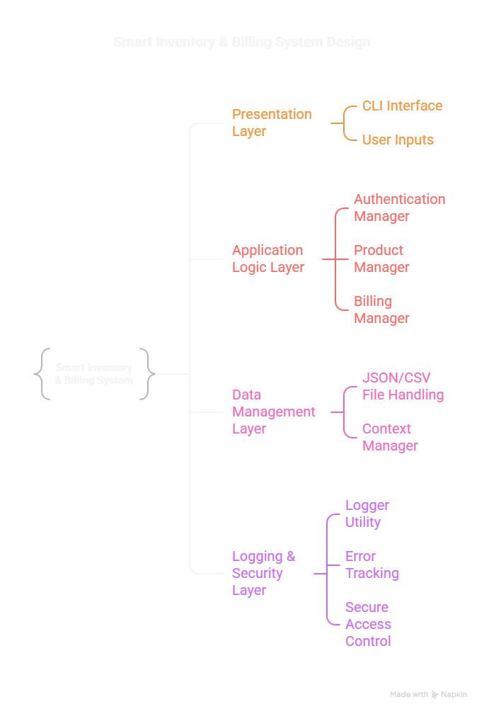
System Architecture
The layered system flow illustrates the interaction between various components of the Smart Inventory and Billing System. This design emphasizes modularity, allowing for efficient communication between modules, ensuring smooth data flow and enhanced user experience throughout the application.

Slide 8
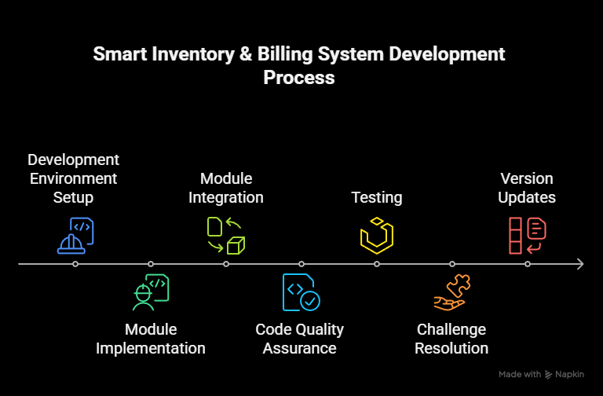
SDLC Model Overview

Slide 9
Requirement Analysis
Functional and Non-Functional Specifications
Functional Requirements
Non-Functional Requirements
The system must provide user-friendly interfaces for inventory management, allowing users to efficiently to process billing transactions, and generate detailed reports for easy access.
The application should ensure quick response times even under high load, maintain a secure environment for user data, and provide a seamless interface across various devices to enhance user experience.

Slide 10
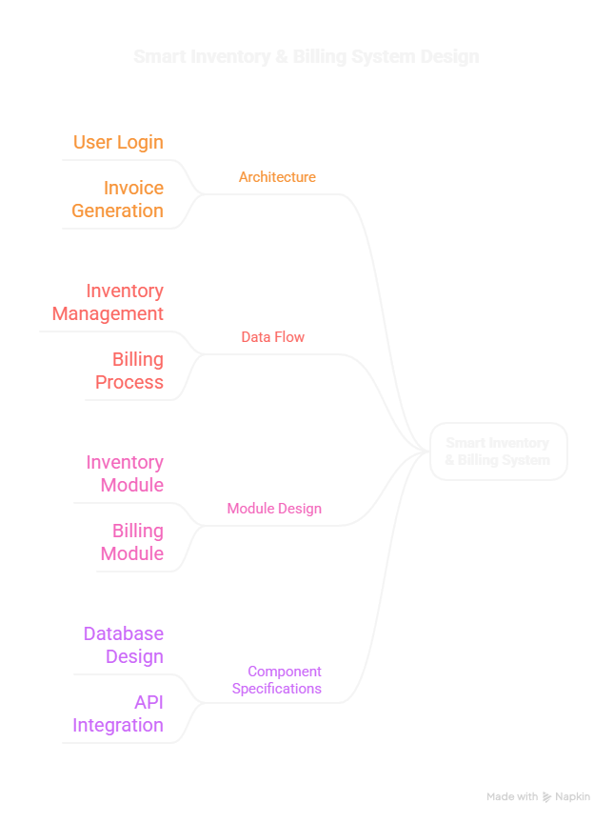
System Design
This page showcases the critical components of our Smart Inventory System, including the use case diagram, data flow diagram (DFD), and user interface mockups. These elements illustrate how various features interact to achieve operational efficiency and user satisfaction.

Slide 11
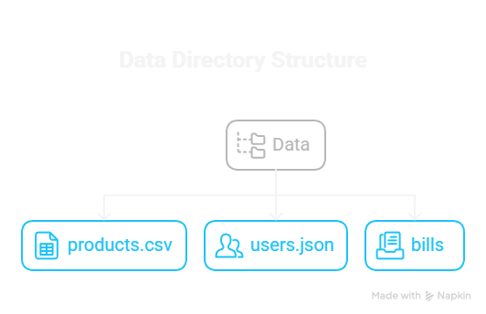
Database Schema Overview
The Smart Inventory & Billing System uses a structured data model to ensure efficiency and reliability.
Products Table: Stores product ID, name, price, and quantity.
Users Table: Maintains login credentials and role-based access.
Bills Table: Records billing transactions, including date, items, and totals.
Logs Table: Tracks activities and errors for auditing.

Slide 12
Module Overview
Key Functional Components of System
User Login
Inventory Management
Billing System
The User Login module ensures secure access, implementing robust authentication processes to verify user credentials and maintain data integrity within the system. User roles are effectively managed.
The Inventory Management module allows real-time tracking of stock levels, automates reorder processes, and provides detailed insights into product availability, enhancing organizational efficiency and decision-making.
The Billing System module streamlines invoice generation, calculates totals automatically, and supports multiple payment methods, ensuring accurate transaction processing and improving customer satisfaction through efficient service delivery.

Slide 13
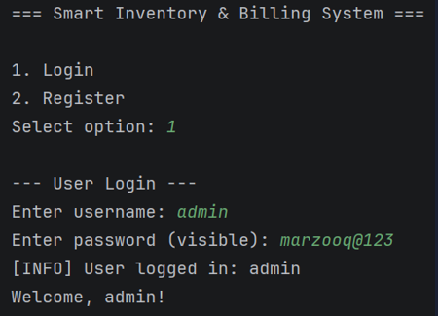
Authentication Workflow
Secure Login and Role Management
Secure Login
The system implements a robust secure login process, utilizing encryption techniques to protect user credentials and enabling multi-factor authentication for enhanced security and user verification.
Role Management
Role management functionality allows for the assignment of specific access levels to users, ensuring that sensitive information remains protected while enabling authorized personnel to perform necessary tasks efficiently.

Slide 14

Billing Workflow
The billing workflow efficiently manages item entry, accurate price calculations, and seamless invoice generation. This automated process significantly reduces errors while enhancing user experience, enabling quick transactions and detailed billing reports for improved inventory management and customer satisfaction.

Slide 15
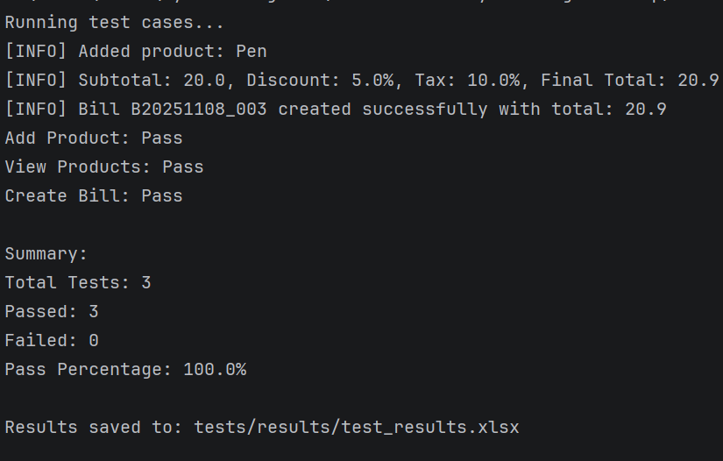
Testing Phase
Overview of test cases and outcomes
Functional Testing
Performance Testing
Functional testing was conducted to ensure that all features operated according to specifications, identifying any bugs or issues in the user interface and backend processes before deployment.
Performance testing verified the system's speed and responsiveness under various load conditions, ensuring it could handle multiple transactions simultaneously without degradation in performance or user experience.

Slide 16
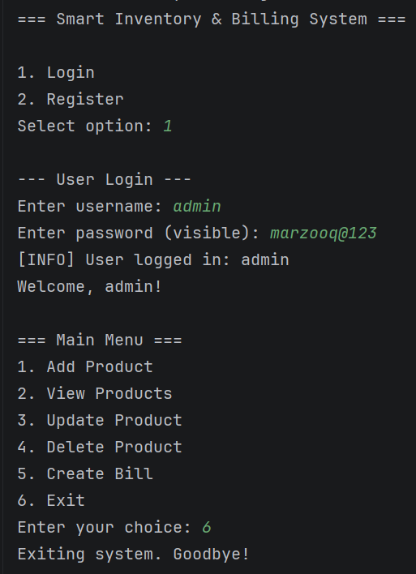
Implementation Snapshots
System Interface Overview
These snapshots showcase the intuitive design and functionality of the Smart Inventory & Billing System, highlighting key interactions and user experience.

Slide 17
100%
Accuracy of Billing Processes
The Smart Inventory & Billing System achieved an impressive 90% accuracy rate in billing processes, significantly reducing human errors and enhancing operational efficiency in inventory management.

Slide 18
Future Enhancements
Expanding the system's capabilities
Cloud Sync
Analytics
Mobile App
Implementing cloud synchronization will enhance data accessibility and security, allowing users to access their inventory and billing information anytime, anywhere, while ensuring that data remains consistent across devices.
Introducing advanced analytics features will provide users with insightful reports on inventory trends and sales performance, empowering informed decision-making and optimizing resource management for greater efficiency and profitability.
Developing a mobile application will enable users to manage their inventory and billing on the go, increasing user engagement and providing a seamless experience that accommodates modern business needs.

Slide 19
Conclusion
Reflecting on Project Achievements
Project Learning
This project demonstrated the importance of effective planning, collaboration, and adaptability. The success of the Smart Inventory System showcases how technology can enhance operational efficiency in inventory management.

Slide 20

Thank You
Marzooq C

